Slide 1

Memento Design Pattern
By: Terry McGlaston Jr & Sean Dsouza
Notes:
Image source - https://cdn-icons-png.flaticon.com/128/2810/2810399.png
Terry

Slide 2
Memento Pattern Introduction:
The Pattern’s Purpose:
Like all design patterns, this one is attempting solve a common problem that occurs in software design
The problem that it attempts to solve is that of creating save states for software or programs.
Other things of note:
In order to create multiple saves of a the program, it creates “memento objects” to save the internal state of the project.
The Memento Pattern was created by Noah Thompson, David Espiritu, and Dr. Drew Clinkenbeard for early HP products. (source below)
Notes:
Terry
Research sources (used in slides 2-4):
https://www.geeksforgeeks.org/memento-design-pattern/
https://refactoring.guru/design-patterns/memento
https://sourcemaking.com/design_patterns#:~:text=In%20software%20engineering%2C%20a%20design,used%20in%20many%20different%20situations.
Erich Gamma, Richard Helm, Ralph Johnson, John Vlissides (1994). Design Patterns: Elements of Reusable Object-Oriented Software (book)

Slide 3
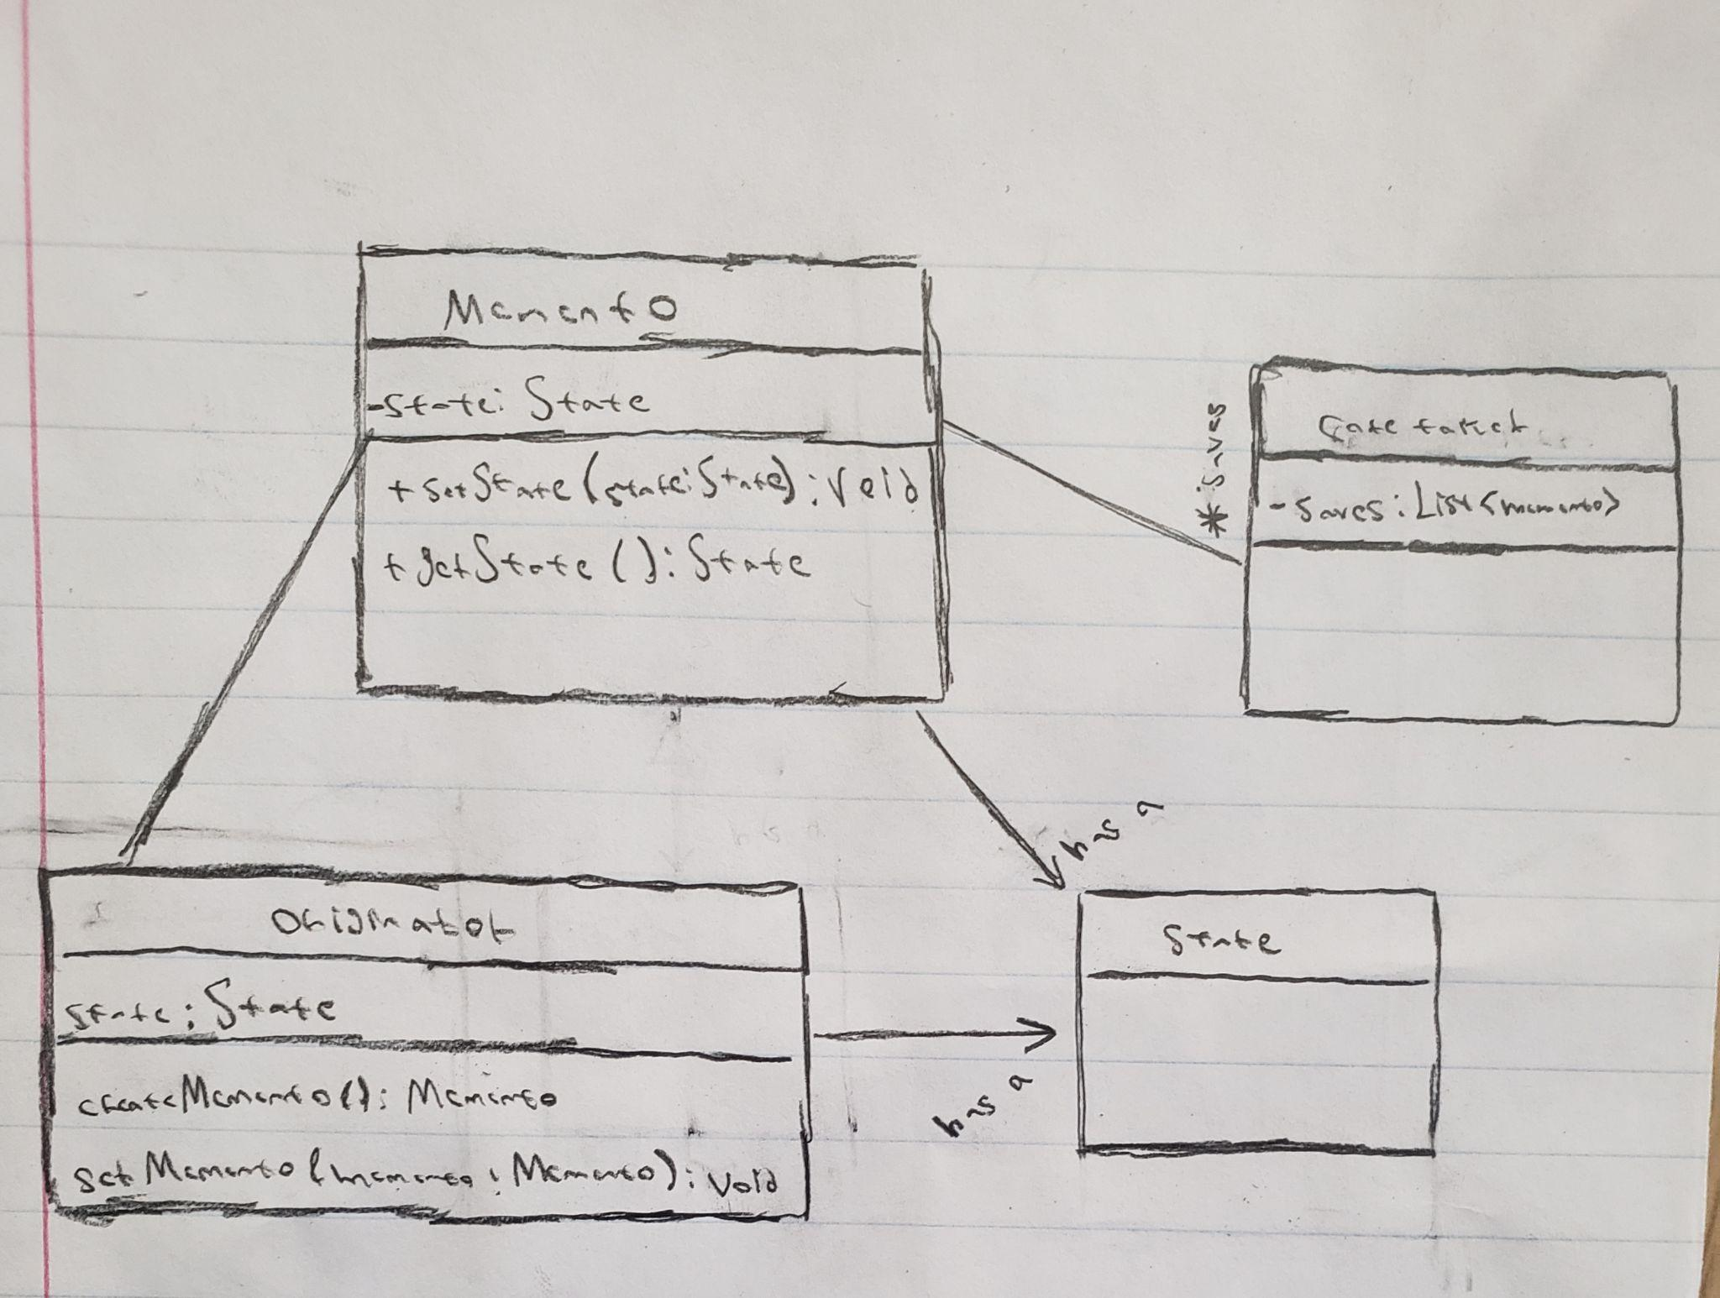
Mechanics of the Memento Pattern:
How does this pattern work?
The memento pattern’s structure contains a memento, a caretaker, a originator, and a state class.
Main class is the caretaker (handles “save states”)
Memento class can be an interface
Originator creates memento
State is in both originator and memento
Notes:
Terry

Slide 4
Other uses of the Pattern (real life examples):
Problems they address and solve:
Can be used for “roll backs” to a previous state
An example of this would be “roll back” connection for fighting games.
Another example would be quick saving and loading in a game.
It can be used to save the internal state of something externally
Like having a repo of updates for a program.
Or how you can create multiple saves of a game or edits of a picture.
Notes:
Terry

Slide 5
Why use the pattern over a list of states?
You don’t have direct access to the states in a simple list.
You miss the ability to interact with the specific save states.
Having the memento patterns allows for branching paths via save states.

Slide 6
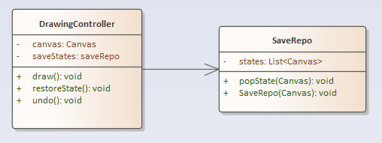
UML of Demo:
Notes:
Sean

Slide 7
Demonstration
Our implementation of the pattern.
Notes:
Sean

Slide 8
Advantages & disadvantages of implementation:
Advantages:
Allows for the saving of states (to undo, redo actions)
With lists, it can theoretically go infinitely
Disadvantages:
The further back you need to undo & redo, the more storage required
If storage is cleared/lost for any reason then you can no longer restore
Notes:
Sean

Slide 9
Memento pattern conclusion (and summary):
You can use the memento pattern to save and restore various states of an object
The basis of rolling back states
Notes:
Sean

